Slide 1

Recurring Delivery Program Training FY27

Slide 2
OVERVIEW
Recurring Delivery (RD) Program Overview
SHFB Partnership
Outreach
Volunteers
Distributions
Storing Food
Delivery Process & Procedure
Statistical Reporting
Temperature Checking Procedure

Slide 3
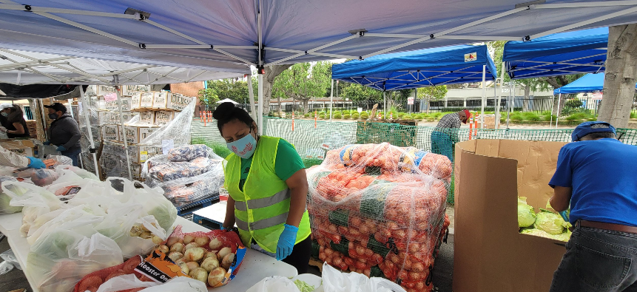
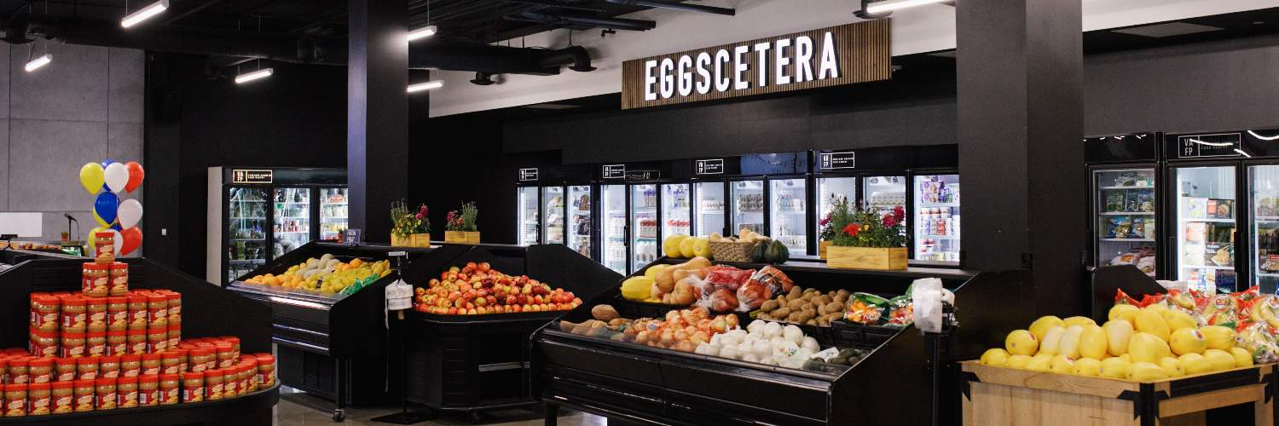
The purpose of Recurring Delivery is to provide consistent access to nutritious food to children, adults, and seniors in need across Orange County. It supports just-in-time distributions, meal providers, or pantry restocks.
Recurring Delivery (RD) Overview

Slide 4
SHFB PARTNERSHIP: PARTNER ENGAGEMENT
We’re here to support YOU!
Working together to strengthen each distribution
We adjust as your needs evolve
Household numbers increase or decrease + storage capacity updates
Ongoing, open communication
We’ll guide you through any updates or changes
You’ll hear from us regularly
Emails, calls, and site visits

Slide 5
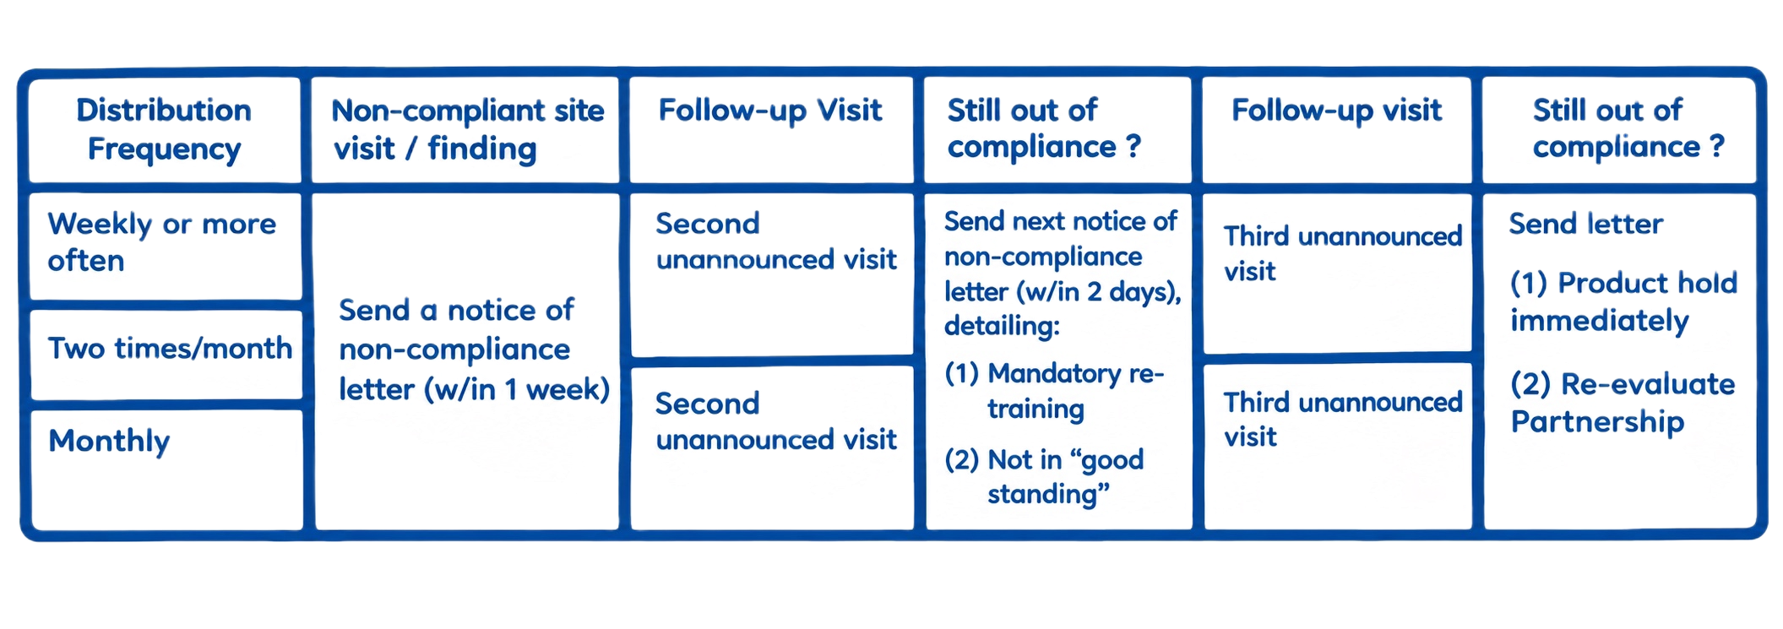
Compliance Visits
Completely unannounced and occur once a year
Moving to digital form which means it’ll be much more in depth
What happens if you’re found to be non-compliant?

Slide 6

Outreach
How will the community know about your distributions?
  Websites
  Social media
  Flyers
  Announcements
Translation services
  We can translate materials to reach more community members
Discover ways to promote consistent volunteer involvement
  More details on next slide

Slide 7
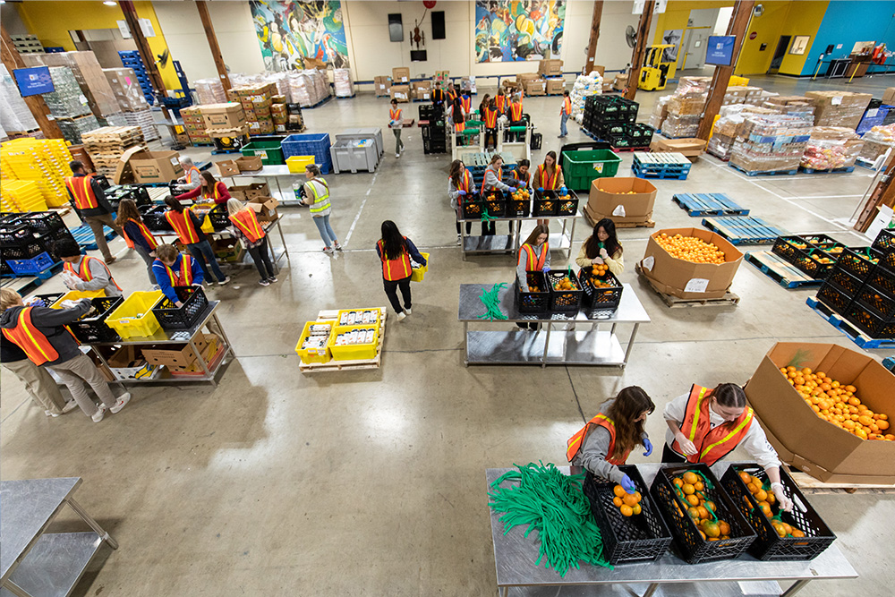
Volunteers: Topics to Discuss
Before Distribution
  Arrival time
  Parking
  Check-in area
  Point of contact
  Access to water and restrooms
During Distribution
  Food Safety Best Practices
  Responsibilities
  Flow of distribution
After Distribution
  Clean up process
  Thank you

Slide 8
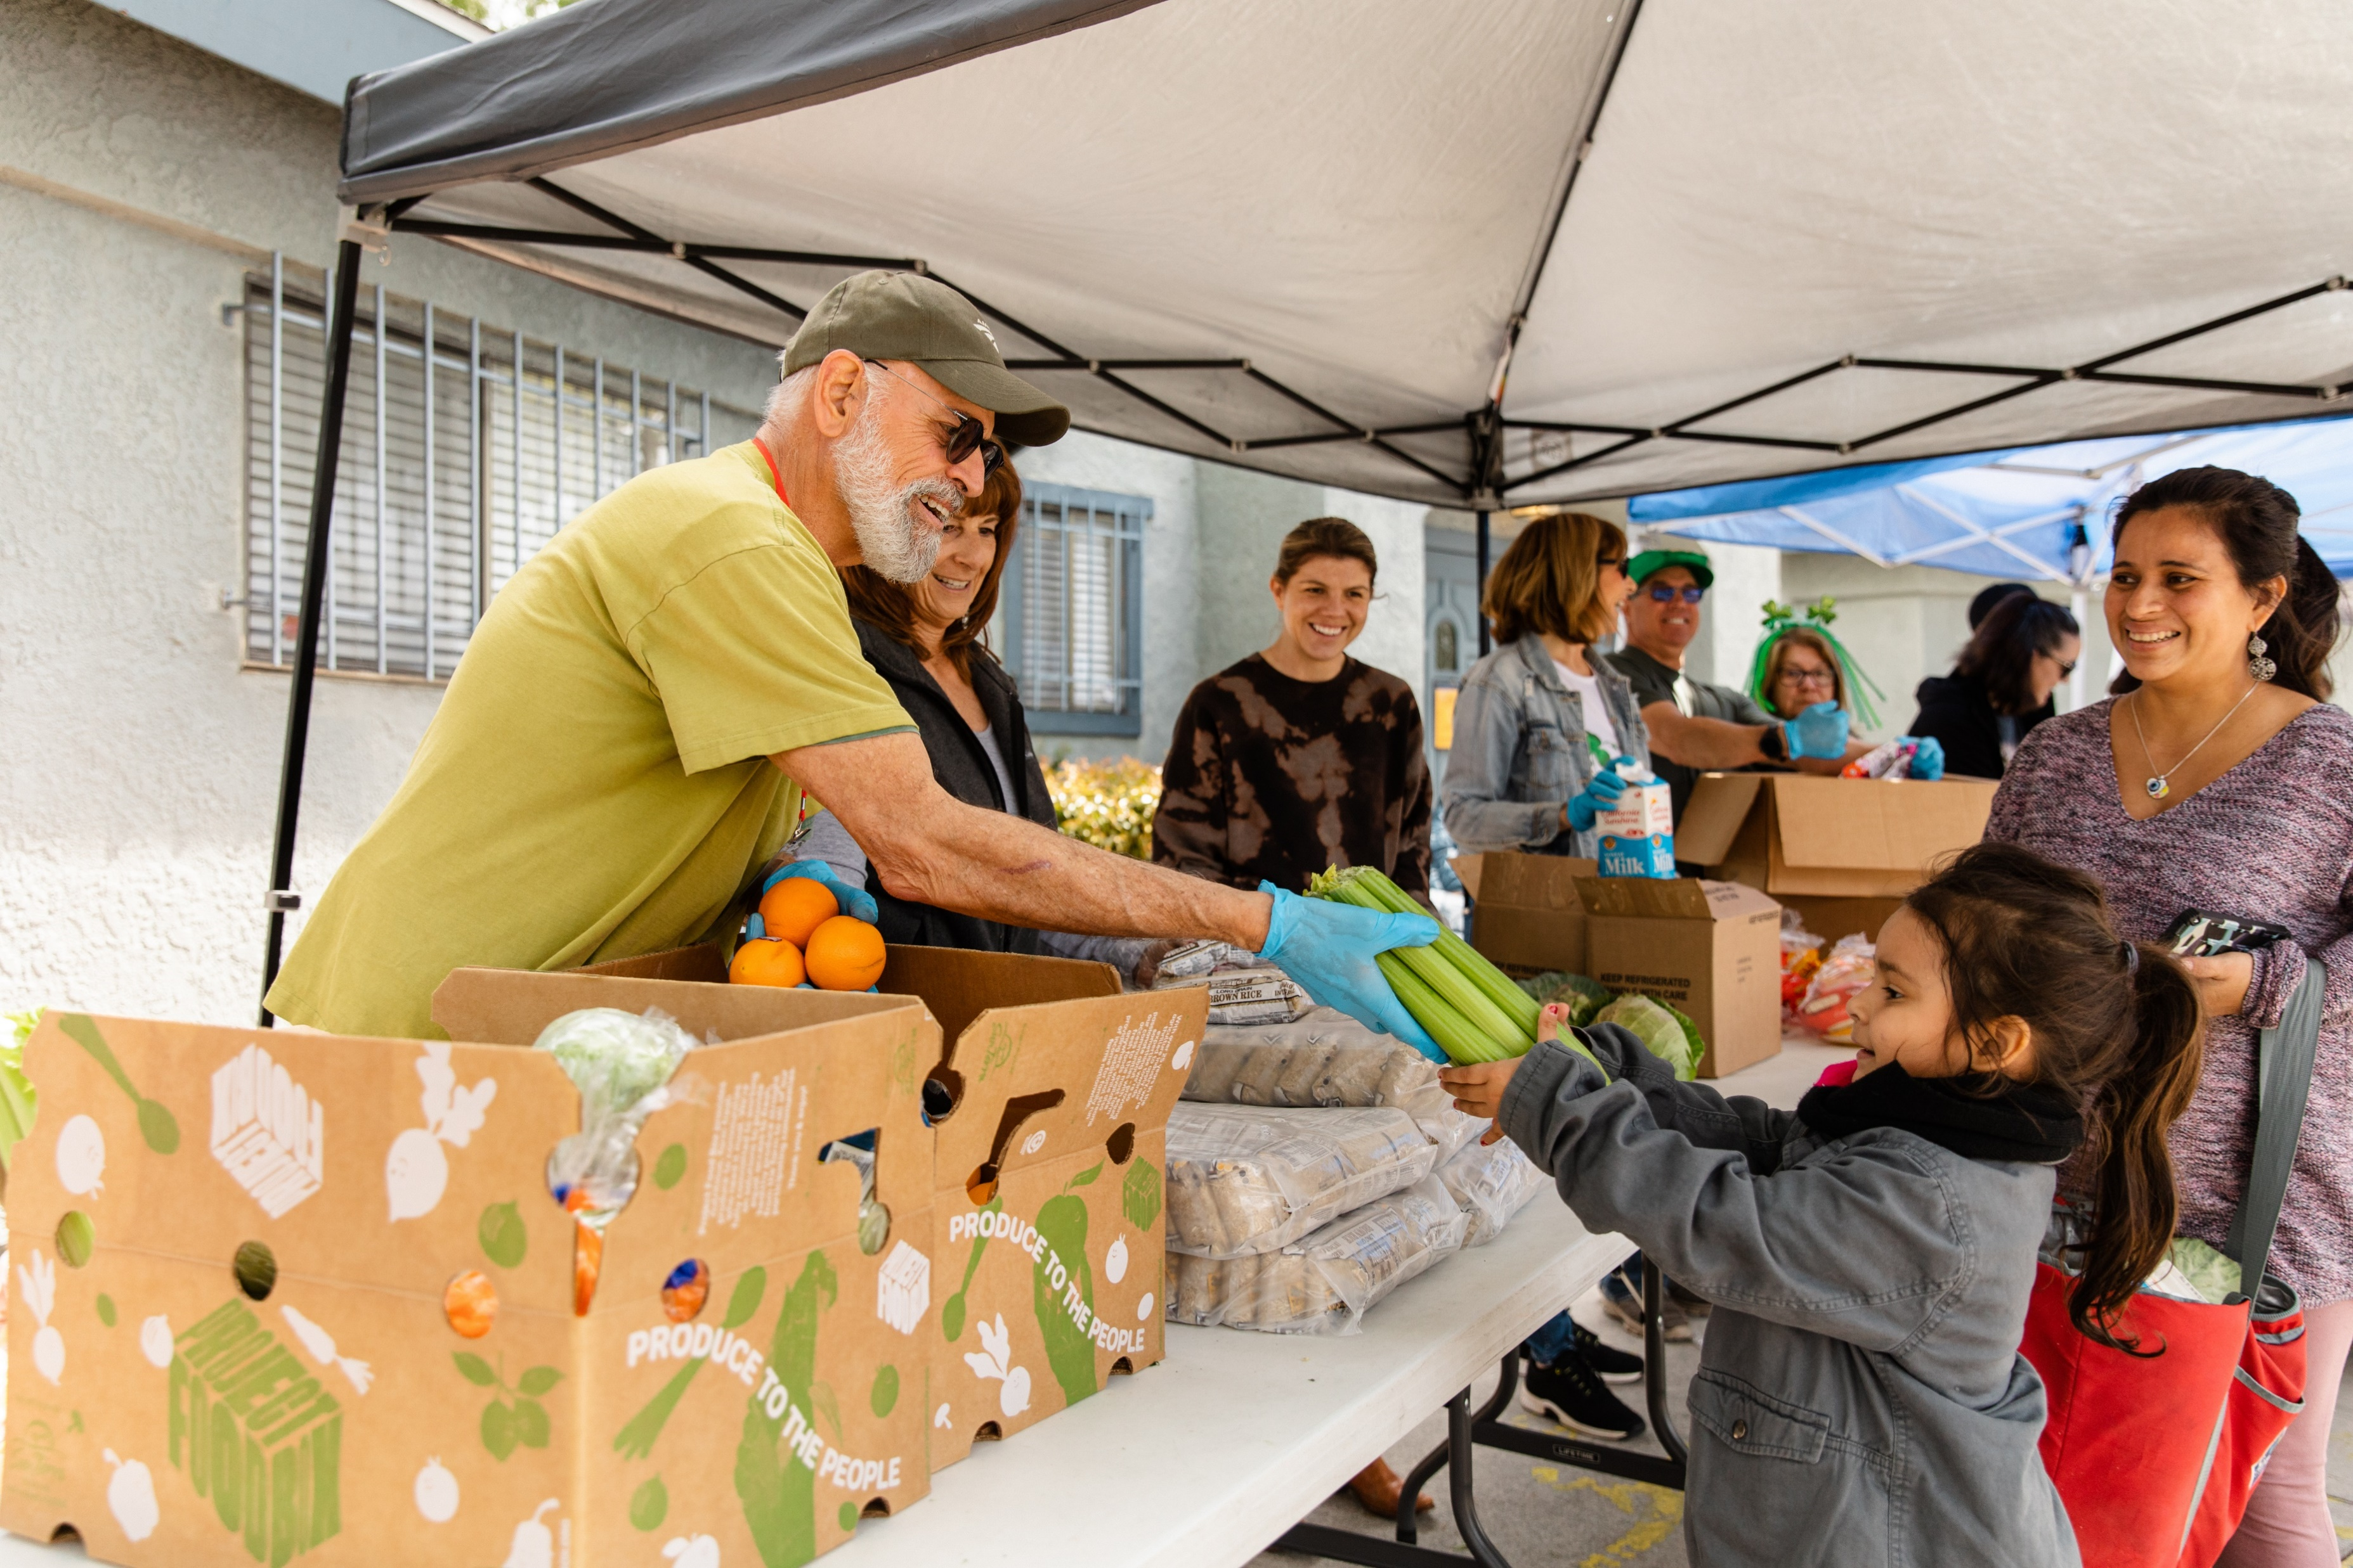
Volunteers Receiving Food
Need to have consistent process
  Either before, during, or after distribution
Volunteer household information must be recorded
No preferential treatment
  Receiving same amount as everyone else

Slide 9
Distributions
There are several ways you can distribute food to the community based on your storage and volunteer capacity, while still incorporating client choice.

Slide 10
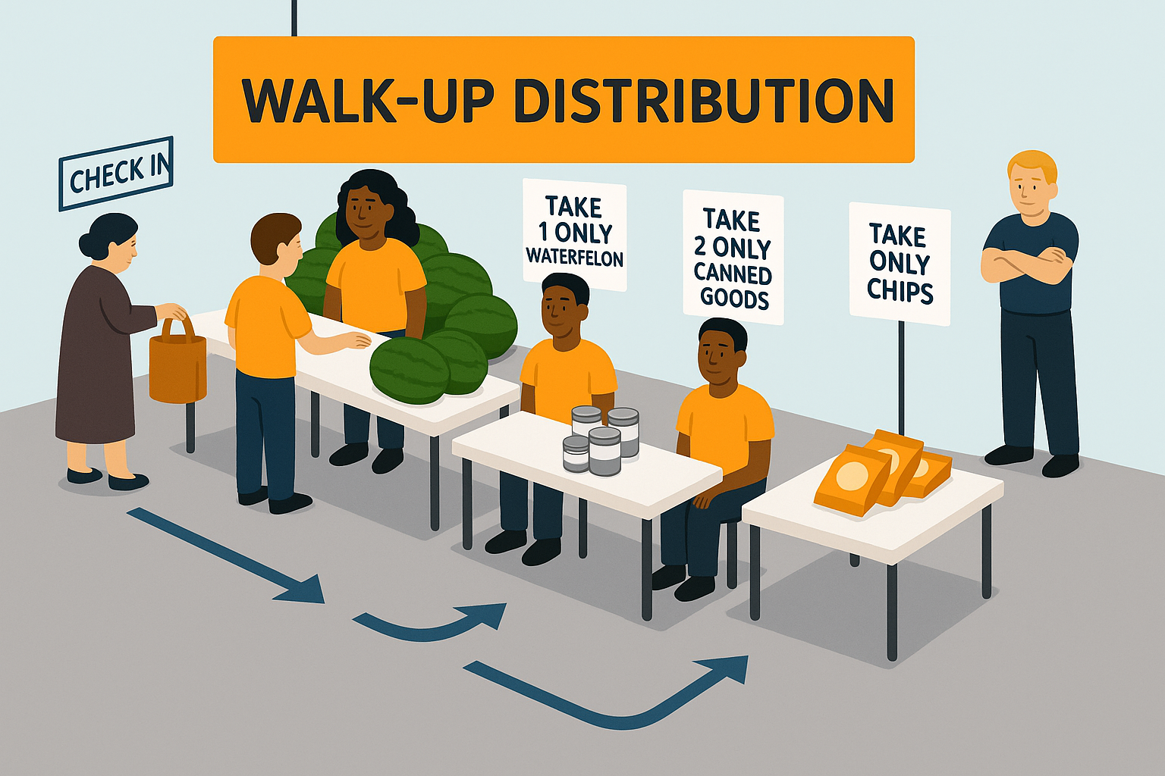
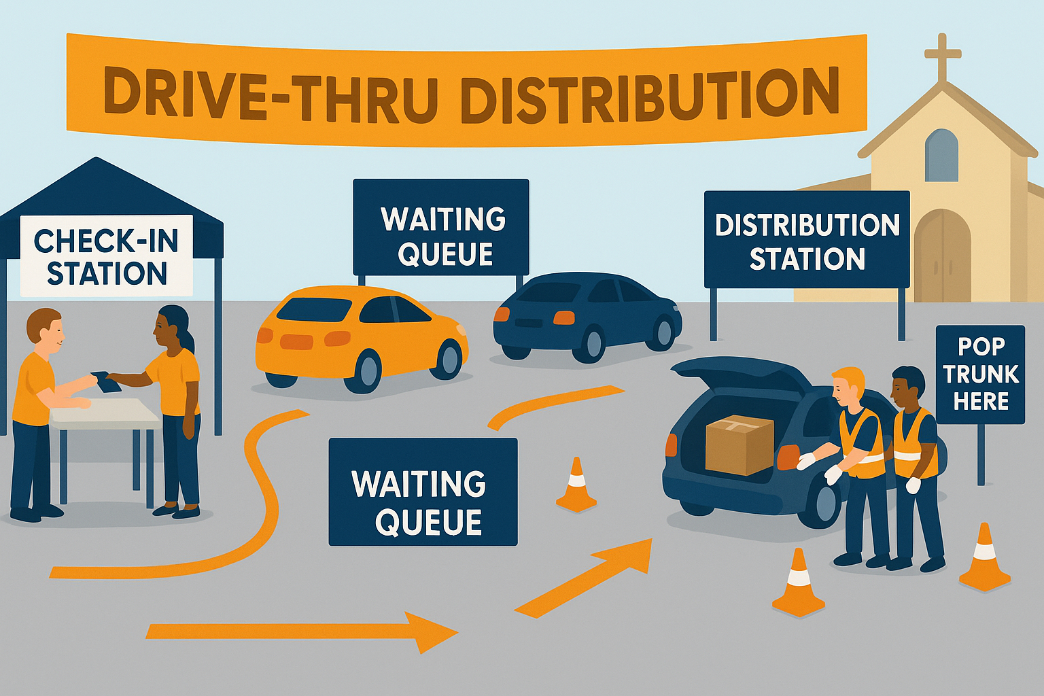
Just-in-time Delivery
Check-in area
Heaviest to lightest
Volunteers or signs with item limits
Use temperature retention devices
  Freezer blankets, ice chests, & thermometers
Primary or Secondary present
Client check-in area
Waiting queue where cars line up
Distribution station
  Freezer blankets, ice chests, & thermometers
  Volunteers load pre-boxed items into trunk
Primary or Secondary contact present

Slide 11
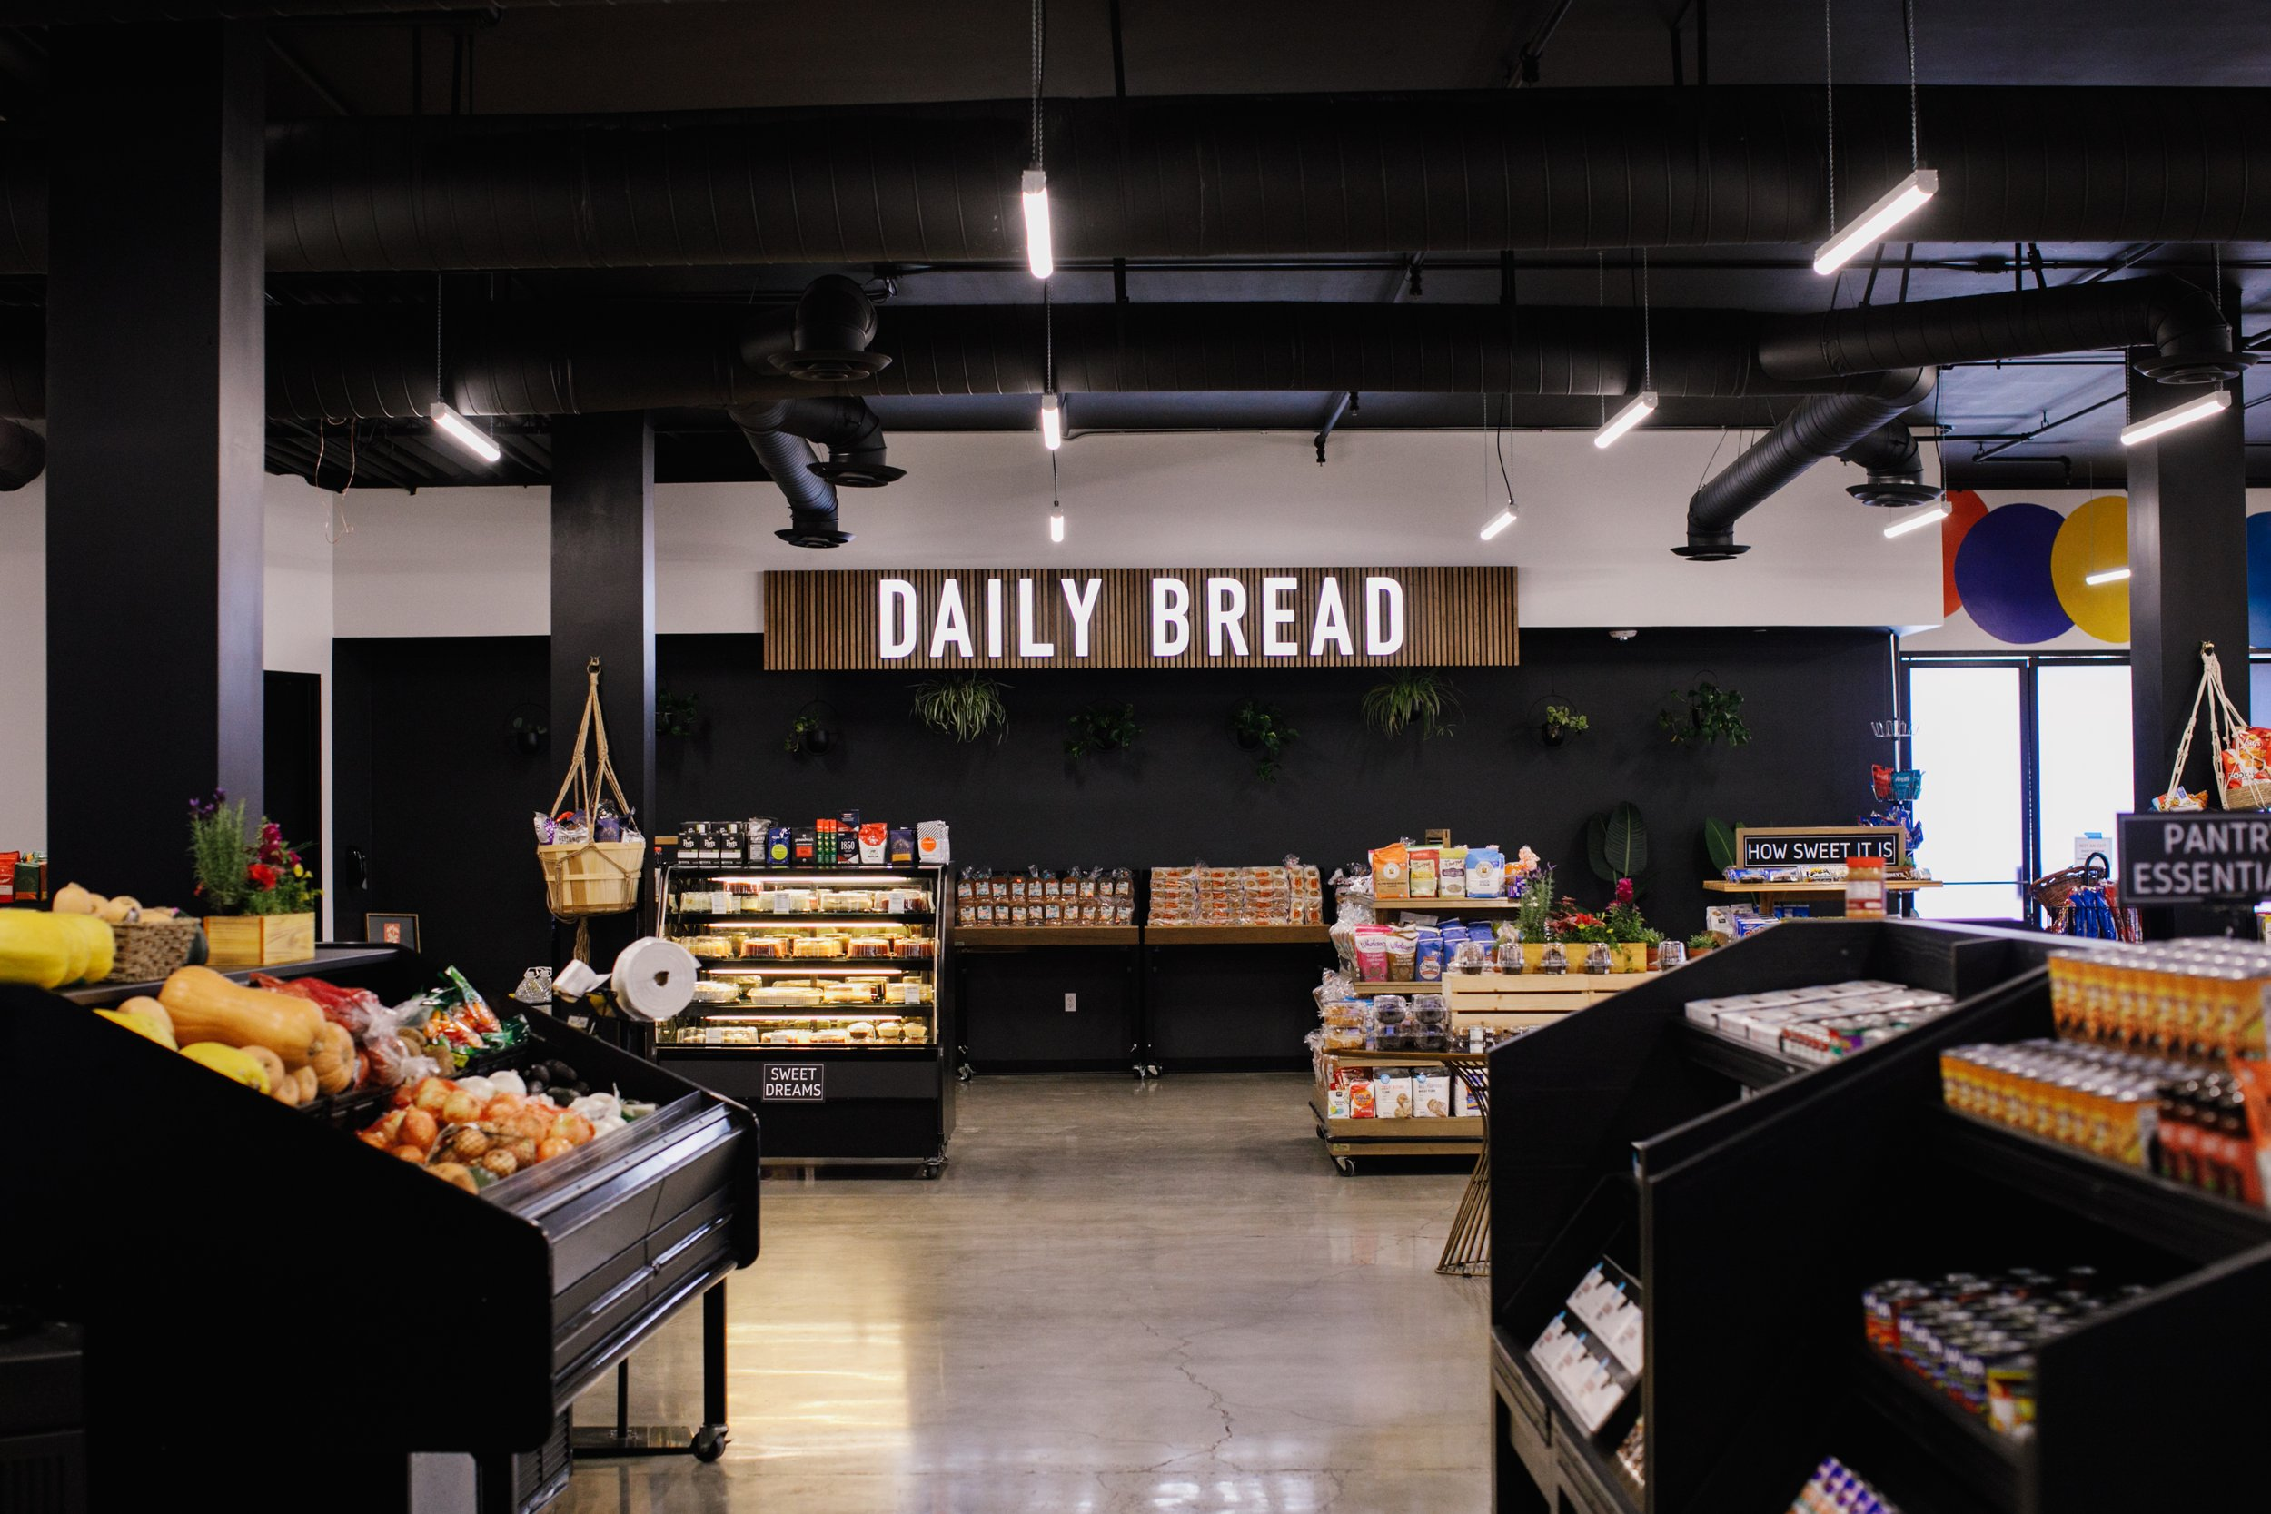
Permanent Pantry
Set pantry hours; weekly/monthly appointments encouraged
Use signage or volunteers to direct clients to pantry
Check-in area to record household info before clients receive food
  Tally sheet, appointment list, online, etc.
Separate storage area by product type
  Encouraged to have item limits posted
Have primary or secondary contact available to resolve issues (not assigned other tasks)

Slide 12

Delivery
Individuals and families sign up to have groceries delivered to their home
  Ex: mobility, immune compromised, etc.
Home delivery application for SHFBOC approval
Household data must still be collected and reported like usual
Food safety:
  Safe Food Handling Certified
  Avoid cross-contamination
  Temperature checking requirements
  Use temperature retention devices
    Freezer blankets, ice chests, etc.
  Directly to client’s home
  Clean containers & vehicles

Slide 13

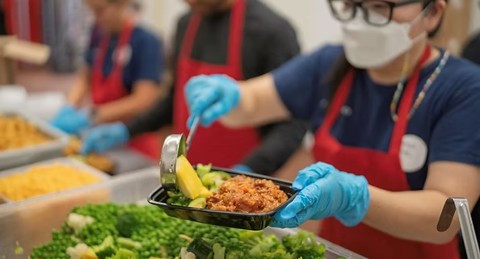
Meal Providers
Must register with OC Health Care Agency’s Environmental Health Division
Manager-level Safe Food Handler required on-site during prep and cooking (valid for 5 yrs)
On-site food consumption (meals or snacks) must be disclosed, inspected by the Health Department, and issued the required permit—regardless of the food source
Monthly meals served must be reported
  Questions? Contact manuela@feedoc.org

Slide 14
Storing Food
Ensuring proper food storage will help with your pantry’s organization as well as maximizing shelf life of products

Slide 15
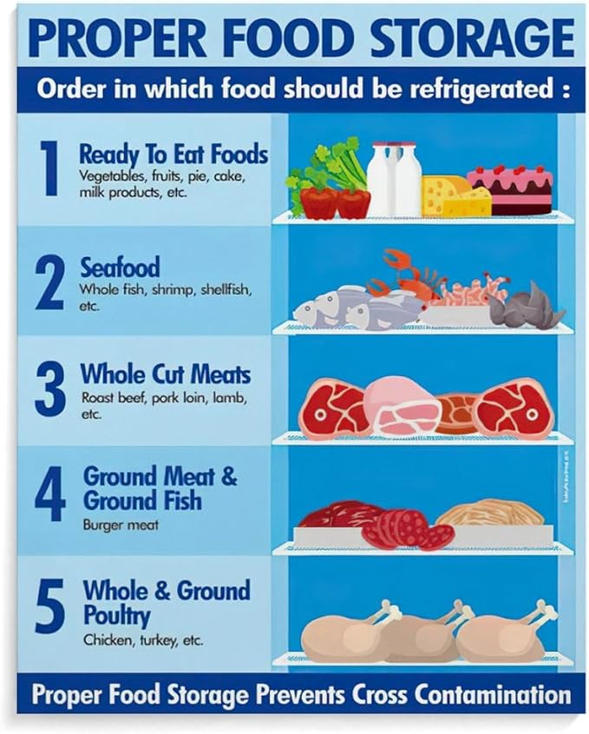
Cold & Frozen Items
Limit amount of time food is out of temperature-controlled environment
  Use freezer blankets or ice chest to keep cold chain intact
Maintain proper temperatures
  41°F for refrigerators & 0°F for freezers
Ensure proper air flow
  Avoid overcrowding
Routinely clean and sanitize storage containers
Avoid cross-contamination
  Store raw items (eggs, meats) under all other items

Slide 16
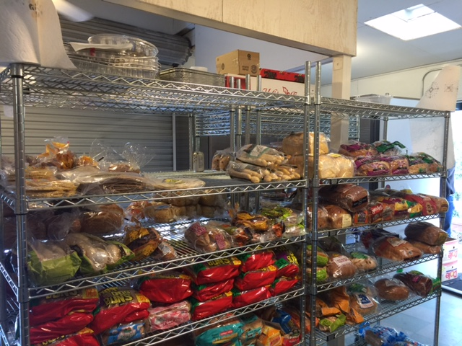
Dry Items
Temperature controlled environment
  50°F to 80°F
No food should ever be stored or placed on floor
  6 inches from ground
  4 inches from wall
FIFO/FEFO
  First In, First Out
  First Expired, First Out

Slide 17
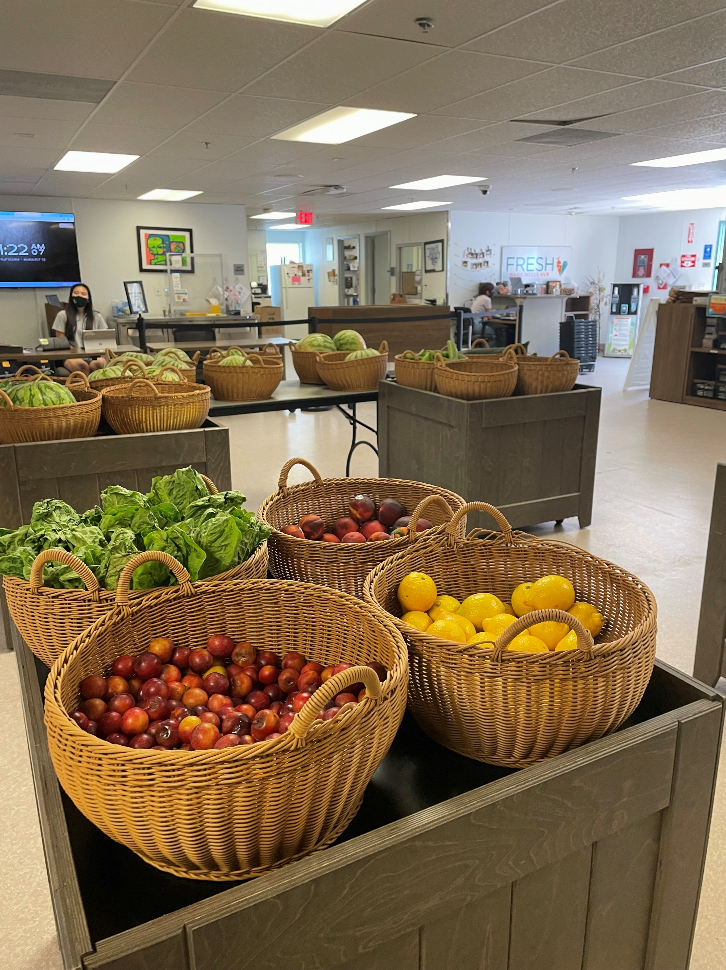
Produce
Focusing on fresh produce this year
Several of the produce items we send are considered “hardy” and can be kept outside of refrigerators
  Ex: apples, potatoes, watermelon, onions, pears, etc.
  Knowing this allows for better pantry organization and frees up space in cold storage units

Slide 18
Delivery Process & Procedure
Deliveries occur at least once per month, up to multiple times per week, with consistent days, times, and location.

Slide 19
Pre-Delivery
PC receives invoice with anticipated delivery 2 business days prior
(We use product allocation for efficient, strategic, and equitable orders)
Calculate item limits based on expected households
(Quantity x pack size / households)
Print required client check-in forms and signage

Slide 20
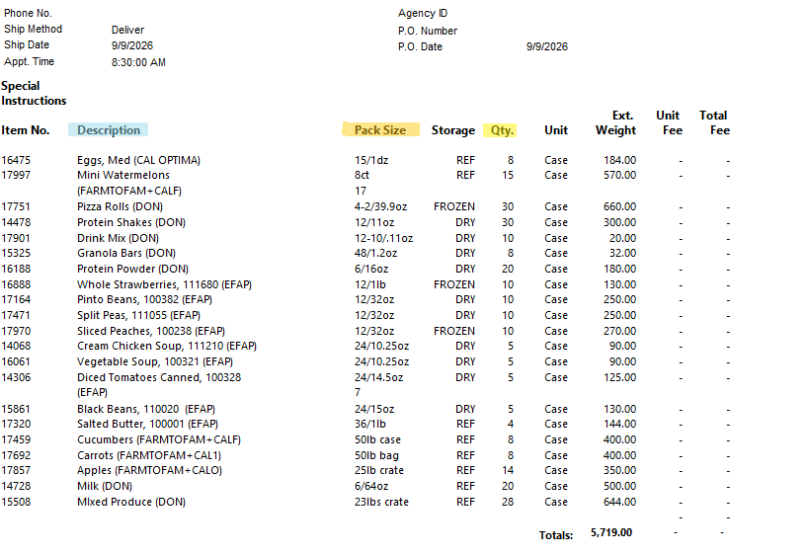
Understanding your Invoice
Qty x Pack Size / Households
Mini Watermelons: 15 x 8 / 60 = 2 per HH
Apples: 14 x 25lb / 60 = 5lbs per HH
Vegetable Soup: 5 x 24 / 60 = 2 per HH

Slide 21
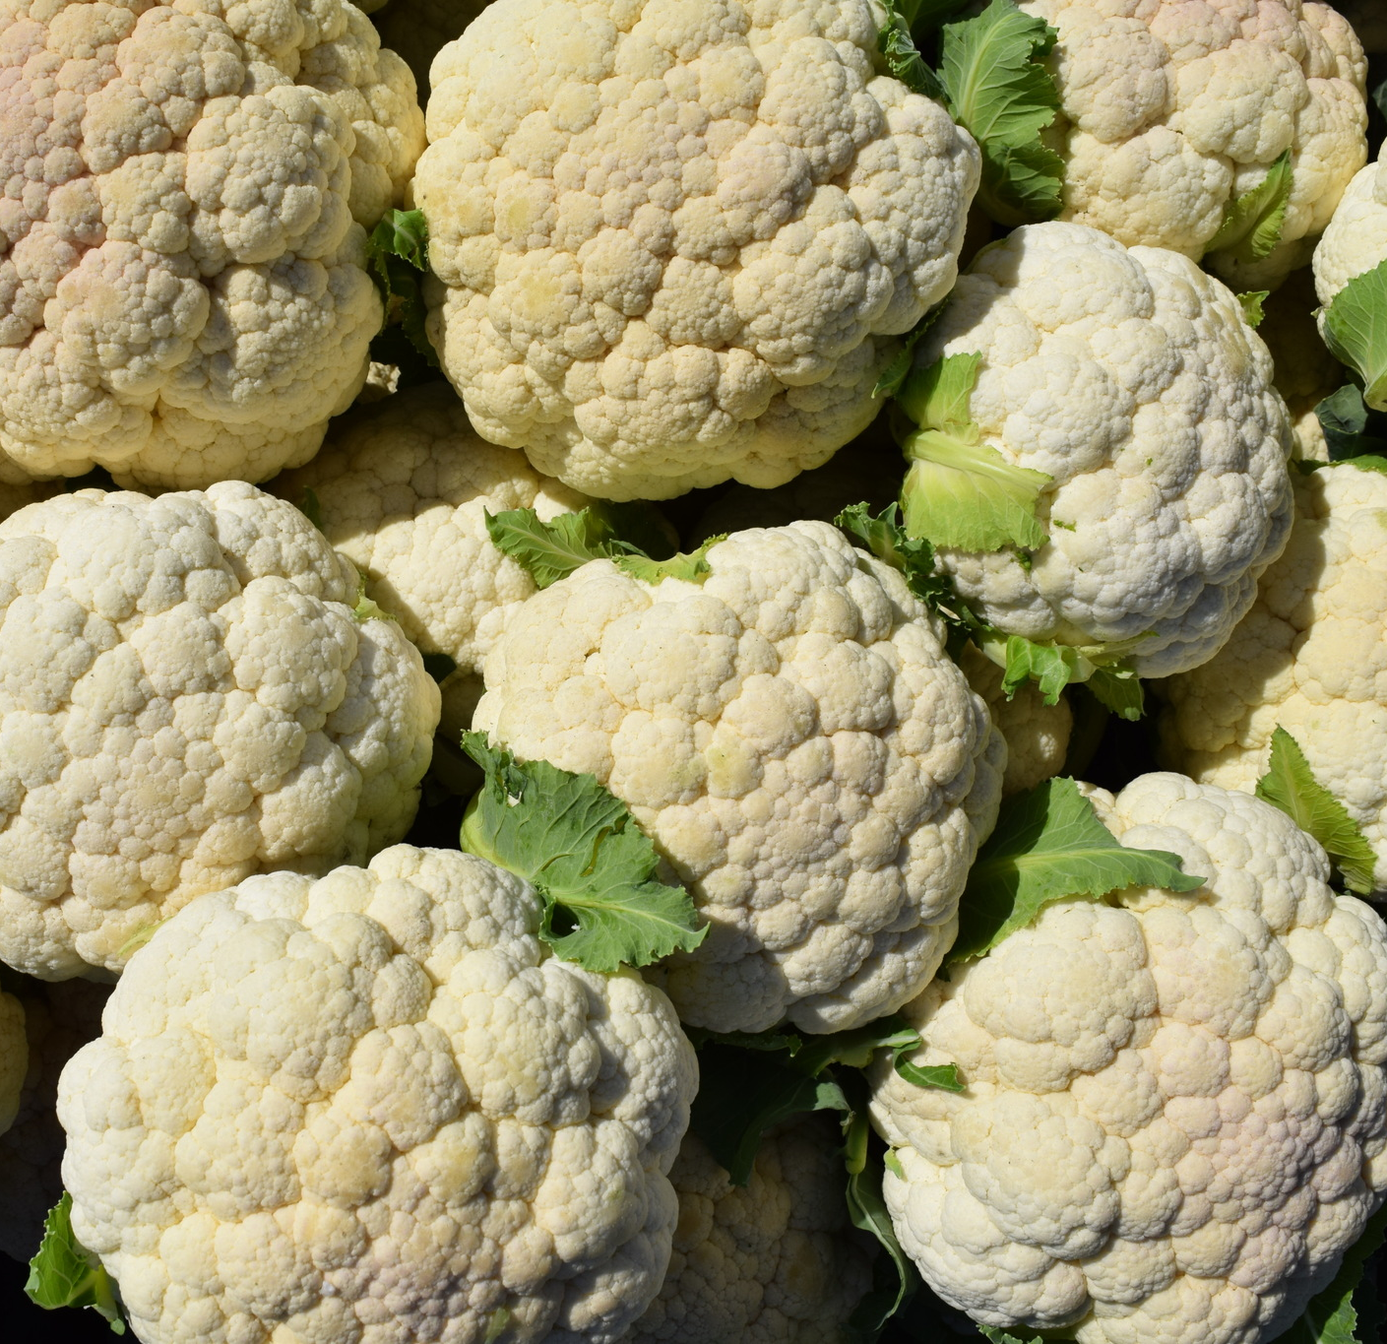
DC Product Overview
Fresh Produce: 4-7 items
Eggs: weekly through June 2027 (subject to change)
Milk and meat: only through donations, Grocery Rescue (GR), or TEFAP
Dry items: donations only
TEFAP: around 8-12 items
GR Product: mixed cases or pallets

Slide 22
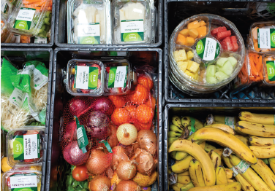
GR Product Overview
GR in our DC!
  Focus on non-GR partners with low capacity
  Highly perishable items → top-offs
  Expect a wide variety of items
Quality of food
  Separate by like or similar items
  If more than 15% waste, reach out to us
Set category limits
You’ll still receive enough food for all HHs you serve

Slide 23
Delivery Windows
Delivery date/time are set by partner site and Second Harvest Food Bank (SHFBOC).
Deliveries arrive within a 1-3 hour window
SHFBOC dispatcher will notify site if delayed and provide updated ETA.
If delivery hasn’t arrived by end of window, contact your SHFBOC coordinator.
Deliveries arriving at the end of window are still considered on time, even if not consistent with prior delivery times

Slide 24
Accepting Deliveries
Primary or Secondary Contact greets and accepts delivery from SHFB driver
SHFB driver unloads pallets at drop location (cannot be on grass)
Partner staff/volunteers set up the distribution or restock pantry space
Driver gives invoice; Primary or Secondary Contact verifies items

Slide 25
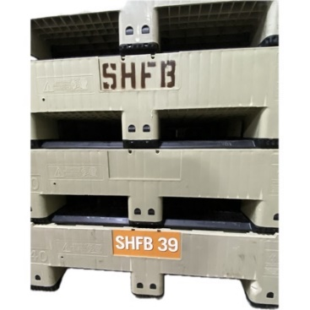
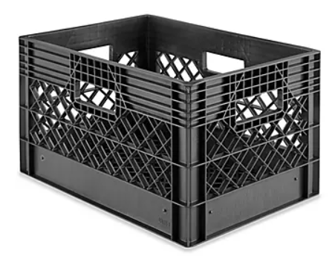
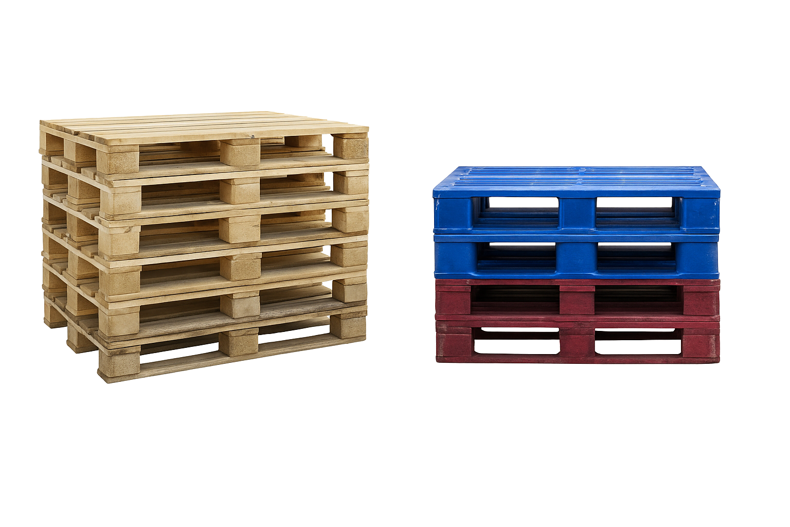
Returning Materials
Specific items must be safely stored and returned at the next delivery or scheduled material pick-up.
Items should be staged and accessible for the SHFB driver
Drivers can only accept items in good condition (no dirt, grass, pests, or trash)
Agricultural
Bins
Milk Crates
Blue, Red, and Pine Pallets (SHFB)

Slide 26
Material Pick Ups (MPU)
Stage all materials at the pallet drop area by the start of your delivery window.
Store together; indoors preferred.
  If outdoors: keep away from trash areas, grass/dirt/mud, and puddles.
  If indoors: not on carpet; keep everything off the floor and on pine pallets—including crates and bins.
Do not need to pallet wrap them
Clear of debris; stack neatly on pine pallets.
  Drivers will not take items with trash or signs of pests.
If pickups are missed/not happening, let the coordinator you work with know

Slide 27
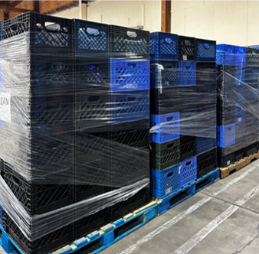
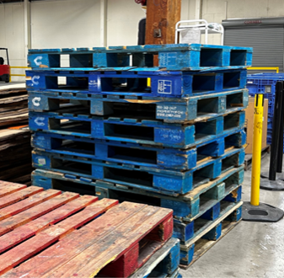
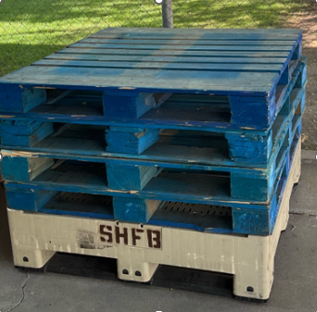
How to Stage Items:
You can stack pallets on top of each other, stack milk crates on top of one pallet, and even stack 2-3 pallets on top of each other then place additional materials on top but pallets MUST NOT be on top of milk crates and the height from the floor should not exceed 5ft 9.5in.

Slide 28
Reschedules & Cancellations
Notify SHFB coordinator of closures at least 3 business days in advance
Late cancellation (within 3 days) → $200 restocking fee
Late reschedule (within 3 days for next day delivery) → $50 restocking fee
Reschedules require SHFB Transportation approval and are not guaranteed

Slide 29
Statistical Reporting
Monthly reports track program efficiency and partner activity, helping Second Harvest advocate for support and funding to address food insecurity in Orange County.

Slide 30
What to Report:
Households served
People served, broken down by age group:
  Children (0-18 years old)
  Adults (19-59 years old)
  Seniors (60+ years old)

Slide 31

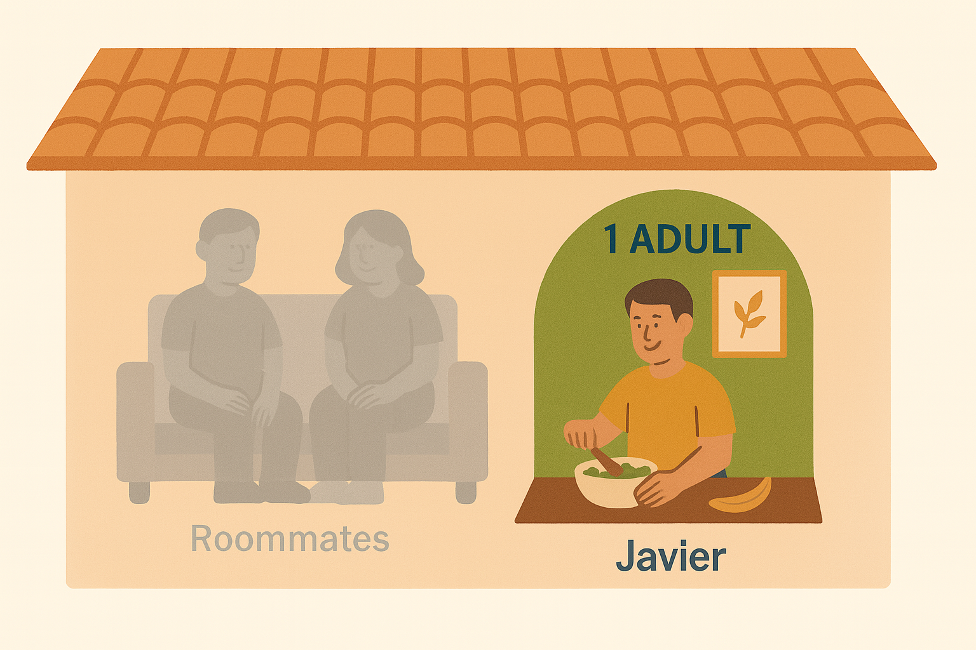

What is a Household (HH)?
An individual or group of people that buy and share food together
HH1: 1 Adult, 3 Children | HH2: 1 Adult, 2 Children
HH 1: 1 Adult
HH 1: 1 Adult 1 Senior 2 Children
Two mothers and their kids share an apartment
Each shops & cooks for themselves and their own kids → 2 separate households
Lives with roommates
Buys & cooks for himself → 1 household
Lives with her mom & 2 kids
Buys & cooks for all → 1 household

Slide 32
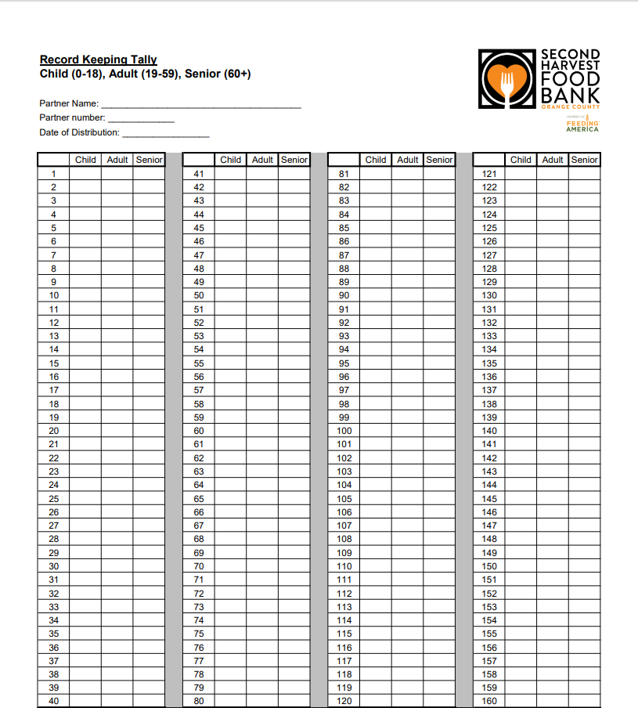
How to collect information:
Establish a system to report households served at each distribution
  Tally sheet, appointments, online, etc.
Record number of children, adults, and seniors per household
Do not add children, adults, and senior column/individuals to determine number of households served
Ensure consistent data collection across distributions
Cannot require proof of ID, residence, income, date of birth or any other info to receive food

Slide 33
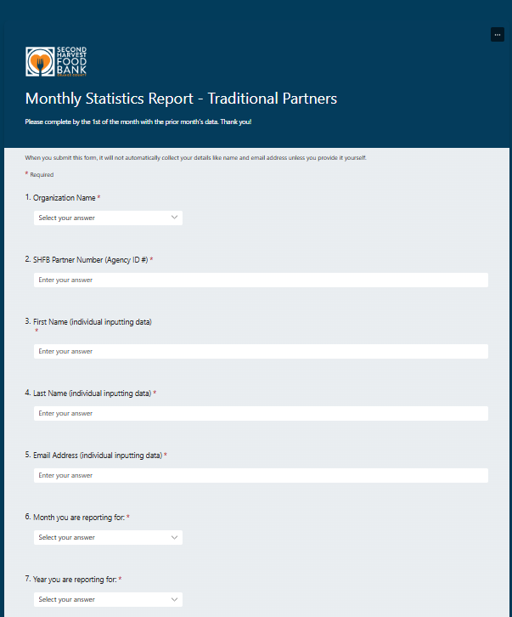
How to Submit Report Online
Click the link:
  https://forms.office.com/r/zh1L7PbCBq
Enter the following information:
  Organization Name
  SHFB Partner Number
  Name and Email of the individual reporting
  Month & Year being reported

Slide 34
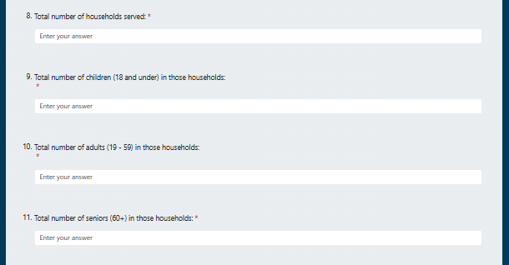
How to Submit Report Online Cont.
Report your service data:
  Total households served
  Total children (0–18)
  Total adults (19–59)
  Total seniors (60+)

Slide 35
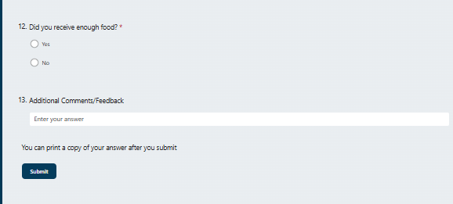
How to Submit Report Online
4. Did you receive enough food?
  Select Yes or No
5. Comments/Feedback
  Any additional information you want us to know!
6. Click Submit after double-checking all entries
7. Need to make a correction?
  Email: partners@feedoc.org

Slide 36
Reminder
DUE DATE:
Questions:
partners@feedoc.org
By the 1st of the month, with data for the previous month’s distributions

Slide 37
Forms

Slide 38
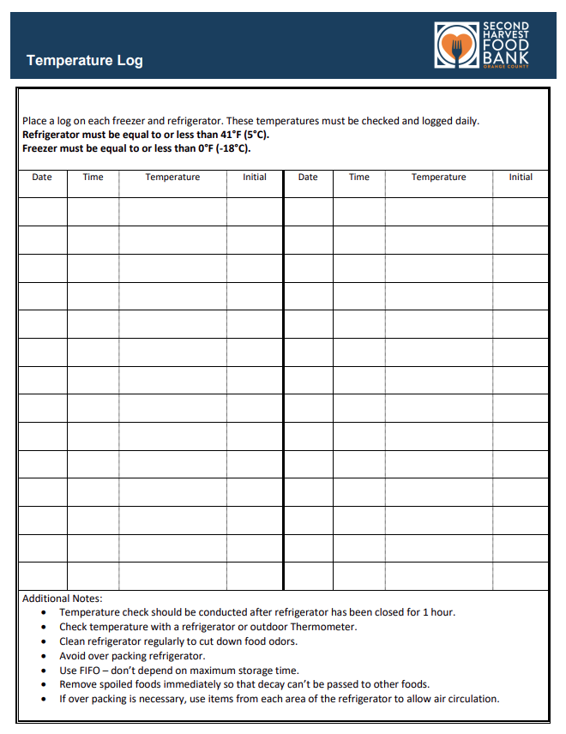
Temperature Logs
For use when SHFB enabled product is stored for any period of time.
Use one temperature log per refrigeration and freezer unit.
Must be recorded every time a staff member or volunteer is on-site
Must keep on file for 6 months

Slide 39
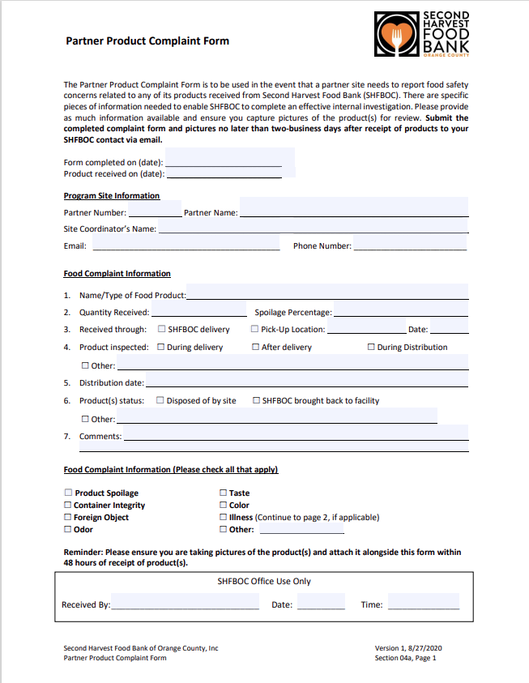
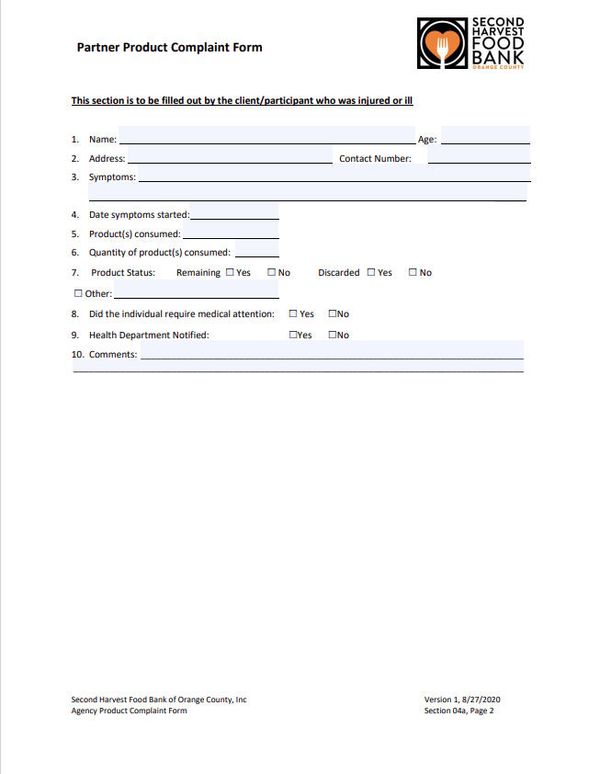
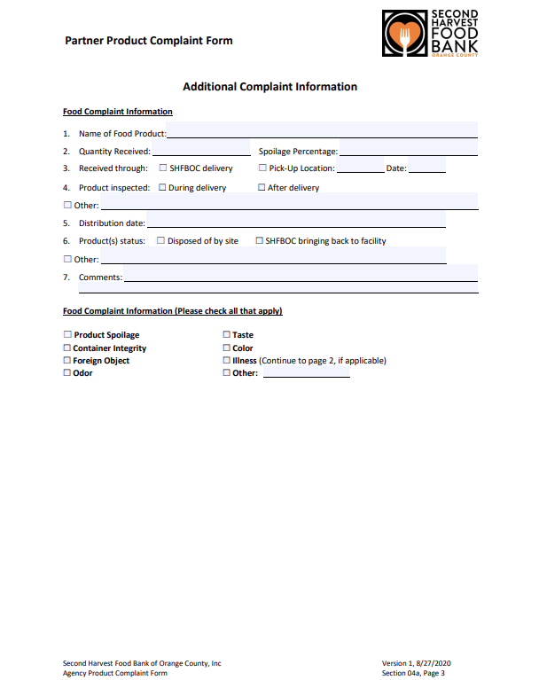
Partner Feedback Form

Slide 40
Next Steps
Check your email for today’s presentations and forms
We’re here to help—feel free to reach out anytime with questions! to
to

Slide 41
Contact Information
Jackie Ledezma
NC Program Coordinator RD
Melanie Aparicio
SC Program Coordinator RD
partners@feedoc.org
O: 949.208.3196
partners@feedoc.org
O: 949.208.3134
Carolina Cruz
Programs & Services Manager
carolina@feedoc.org
O: 949.208.3192

Slide 42
  Questions?

