Slide 1

Temperature Monitoring
Just In Time Delivery

Slide 2

Introduction
Temperature Monitoring
Updated Temperature Monitoring Requirement
Food being distributed from just-in-time deliveries must be checked to guarantee it is within the correct temperature range
To ensure food safety during distributions with just-in-time deliveries
Partners will be provided with Digital Probe Thermometers and an Infrared (IR) Thermometer
Notes:
Updated Temperature Monitoring Requirement:
As we work with just in time deliveries, we are committed to ensuring food safety and have updated our temperature monitoring process
To help with this process partners will be provided with Digital Probe Thermometers and Infrared Thermometers

Slide 3
Who is Required to Temp?
Temperature Monitoring
Who is required to temp?
  Any partners receiving just-in-time deliveries must check the temperature of that food
  This specifically affects:
    College Pantries
    Mobile School Pantries
    Senior Grocery
    Traditional Partners
Just-in-time delivery
  Deliveries from SHBOC to a partner site that does distribution after delivery
Notes:
Joey

Slide 4
Calibrating Thermometer
Temperature Monitoring
Calibrating
  Checking that the thermometer is showing the correct temperature.
  When should you calibrate:
    Before first use
    Part of their routine when getting ready to set up distribution
    After dropping or bumping it
    After extreme temperature changes
    If readings seem “off”
Notes:
Isaac

Slide 5
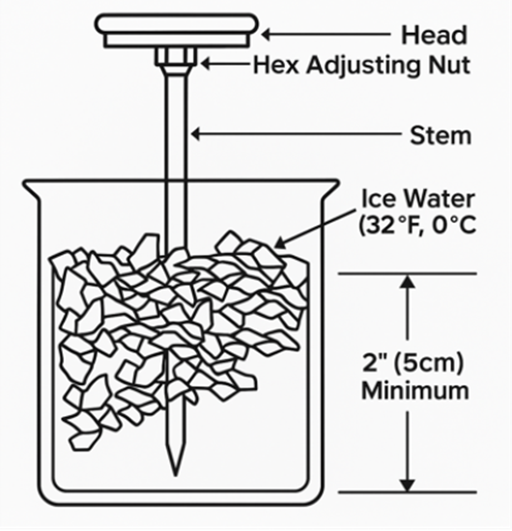
Calibrating Thermometer
Temperature Monitoring
Calibrating
  Using a calibrated probe thermometer:
    How to calibrate a probe thermometer:
      USDA - Calibrating a Thermometer: Ice Water Method
    Instructions for calibrating digital probe thermometer found on the box
  Using an IR thermometer
    How to verify accuracy for IR thermometer: Calibrating an Infrared Thermometer: Ice Water Method
    Important to follow manufacturer’s guidelines
Notes:
It’s important to know how to calibrate probe thermometer, we’re going to share with you a video from USDA on how to calibrate a thermometer using the ice water method.
https://youtu.be/KCjb85pZb6c?si=T5W0KAX-GD9IHtD2
With IR thermometer, it’s no so much calibrating as it is testing it’s accuracy. With IR thermometer you will do the same with in creating an ice water bath and pointing the thermometer in the dead center to verify its accuracy.
If you every purchase and use your own digital probe and IR thermometer, it’s important to follow the manufacturer’s guidelines.

Slide 6
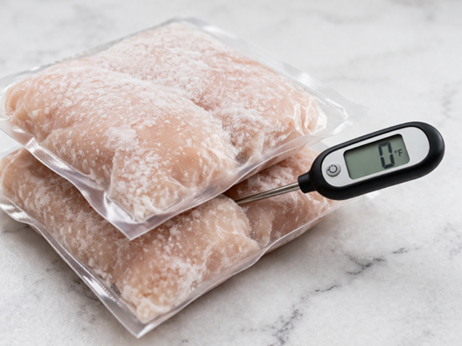
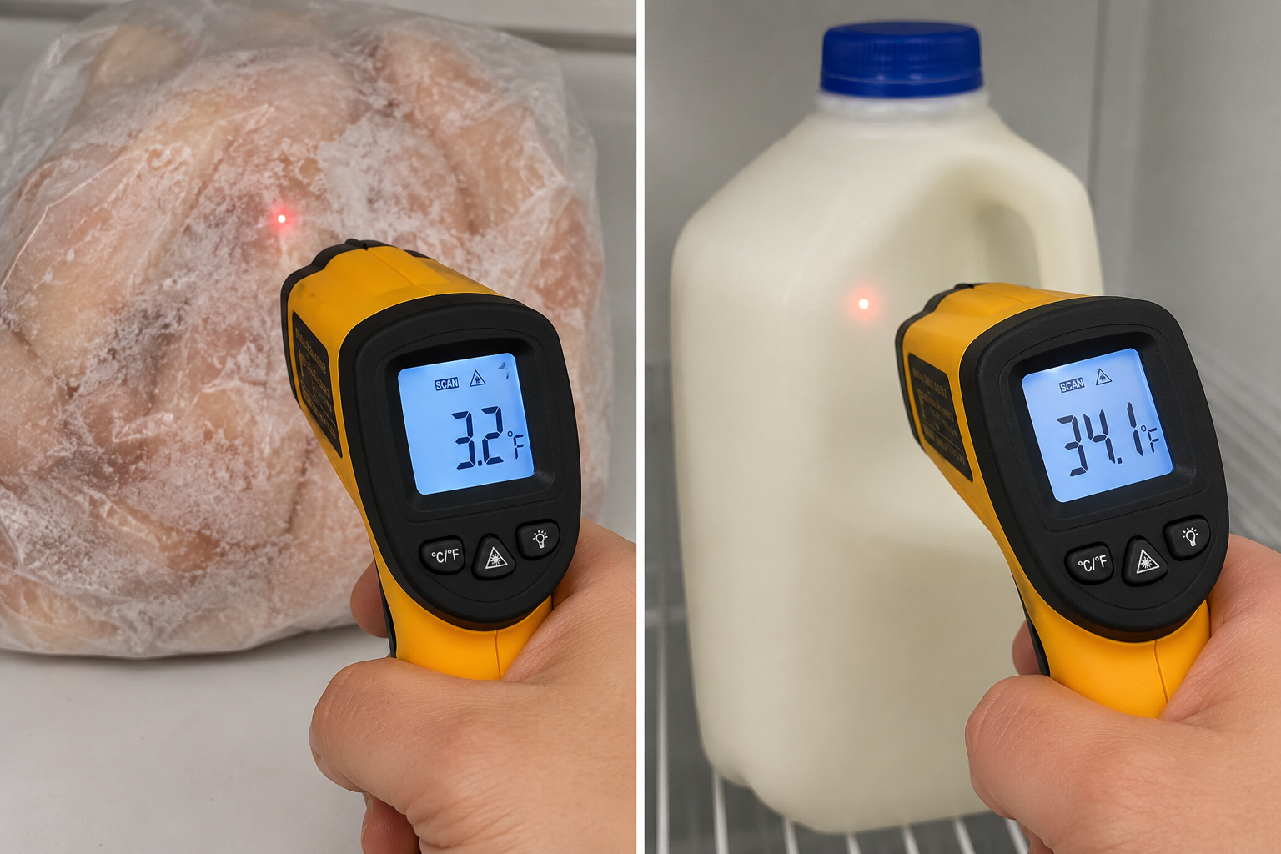
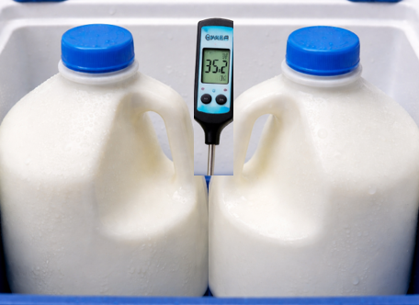
How to Check the Temperature
Probe Thermometer Temperature Monitoring
How to Check Temperatures
  Sample one cold and one frozen item from the load
    Probe thermometer: place between two similar items (do not puncture or open packaging
    IR thermometer: point IR laser directly at the center of the product
  If MILK or CHICKEN are present, those items MUST be checked
  Wait for stable reading
Notes:
How to Check Temperatures
Sample one cold and one frozen item from the load
Probe thermometer: place between two similar items (do not puncture or open packaging
IR thermometer: point IR laser directly at the center of the product
If MILK or CHICKEN are present, those items MUST be checked
Wait for stable reading

Slide 7
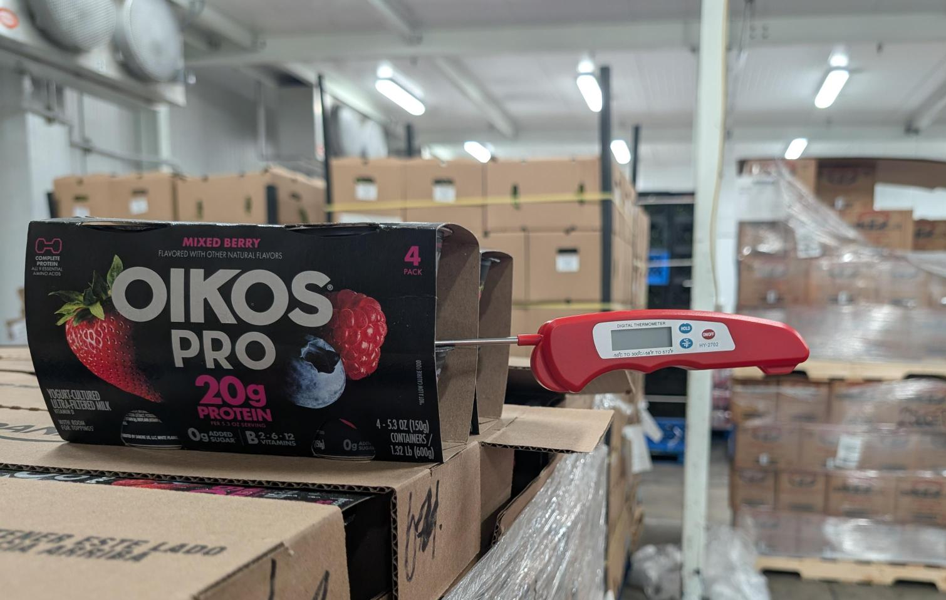
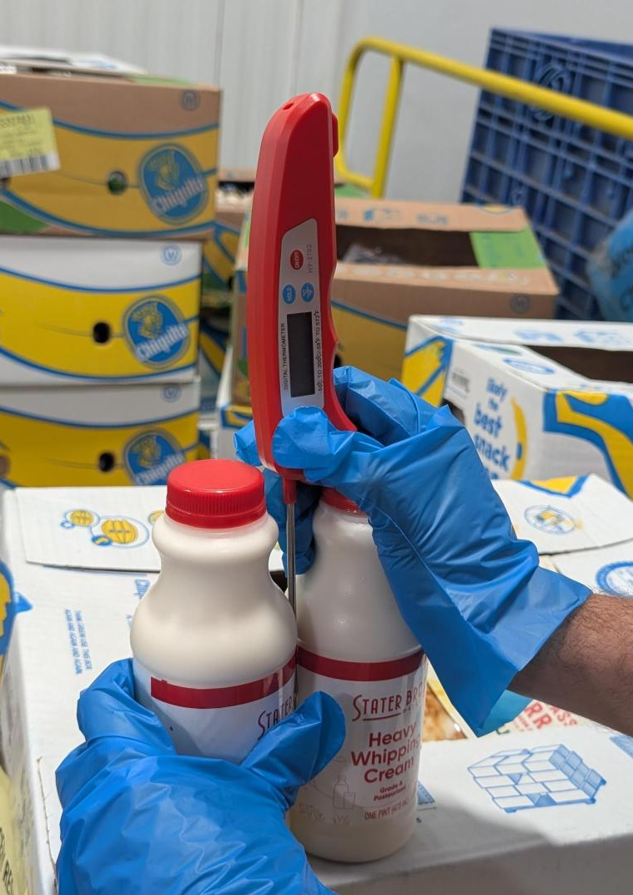
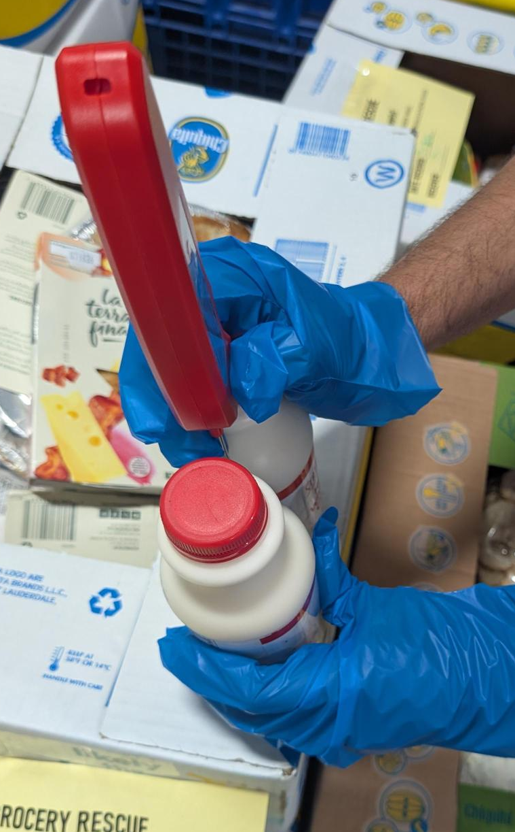
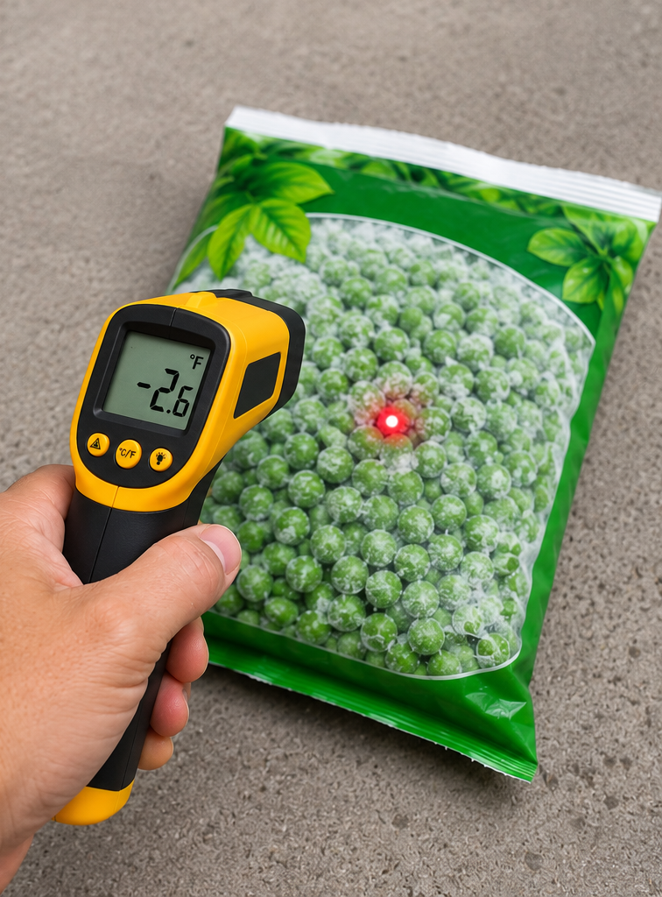
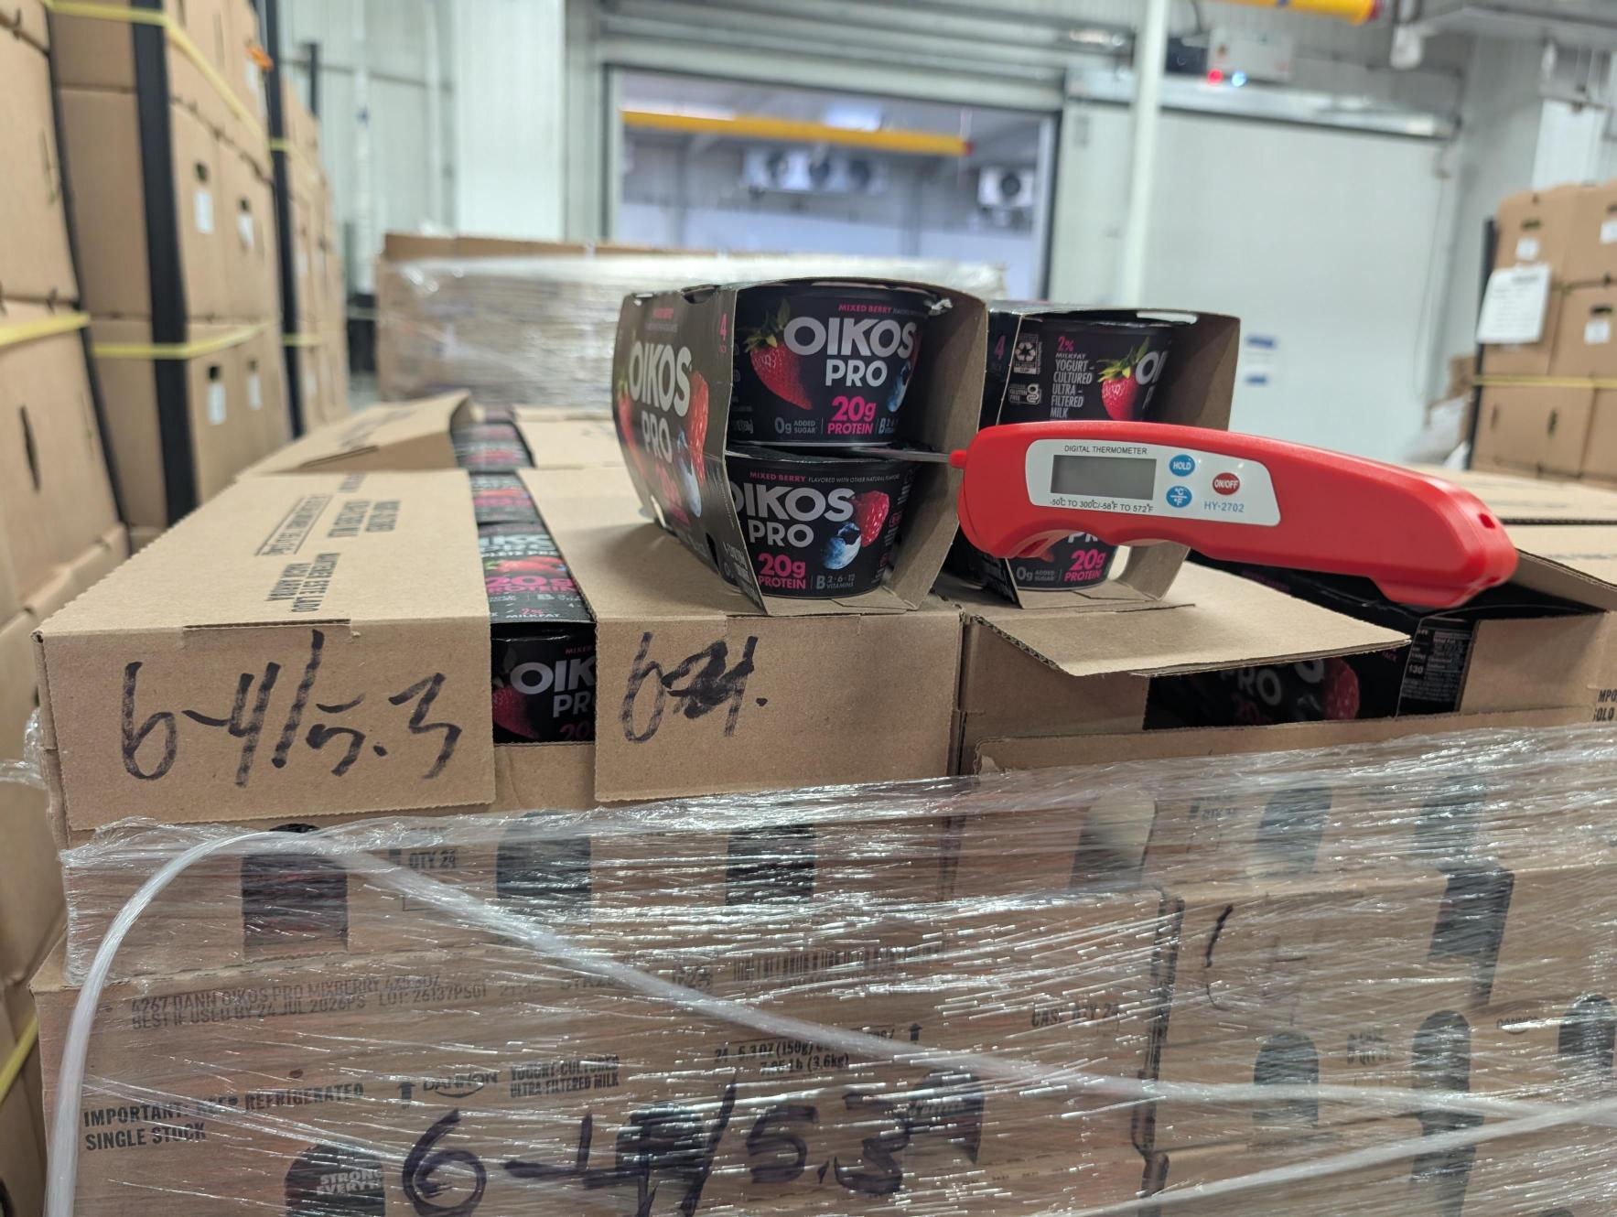
How to Check the Temperature
Temperature Monitoring
How to Check Temperatures
  Ensure the coldest part of the package is being measured
  Use best judgment and avoid air pockets when measuring temperature
Notes:
How to Check Temperatures
Ensure the coldest part of the package is being measured
Use best judgment and avoid air pockets when measuring temperature

Slide 8
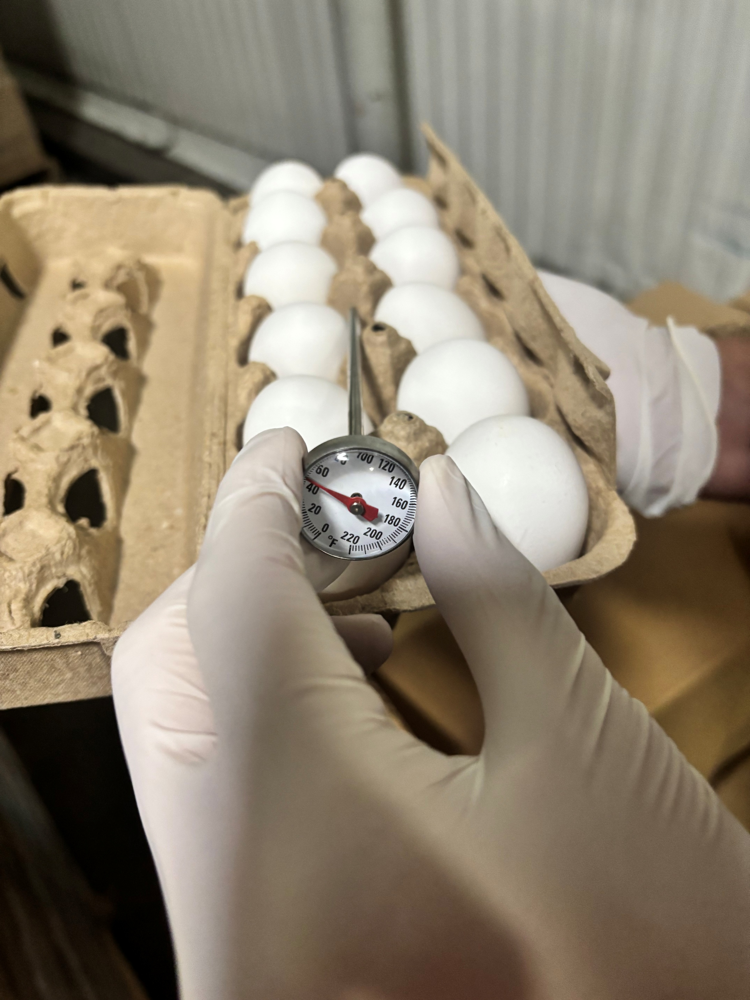
How to Check the Temperature
Temperature Monitoring
How to Check Temperatures
  If your cold sample is eggs:
    Because eggs can easily warm up in our hands, eggs should very seldom be handled. To check the temperature of the egg, we will be checking the ambient temperature around the eggs
    Probe thermometer: Make sure the divot on the stem of the thermometer is near the egg
    IR thermometer: Select one egg and aim the IR thermometer at the center of the egg
Notes:
How to Check Temperatures
Ensure the coldest part of the package is being measured
Use best judgment and avoid air pockets when measuring temperature

Slide 9
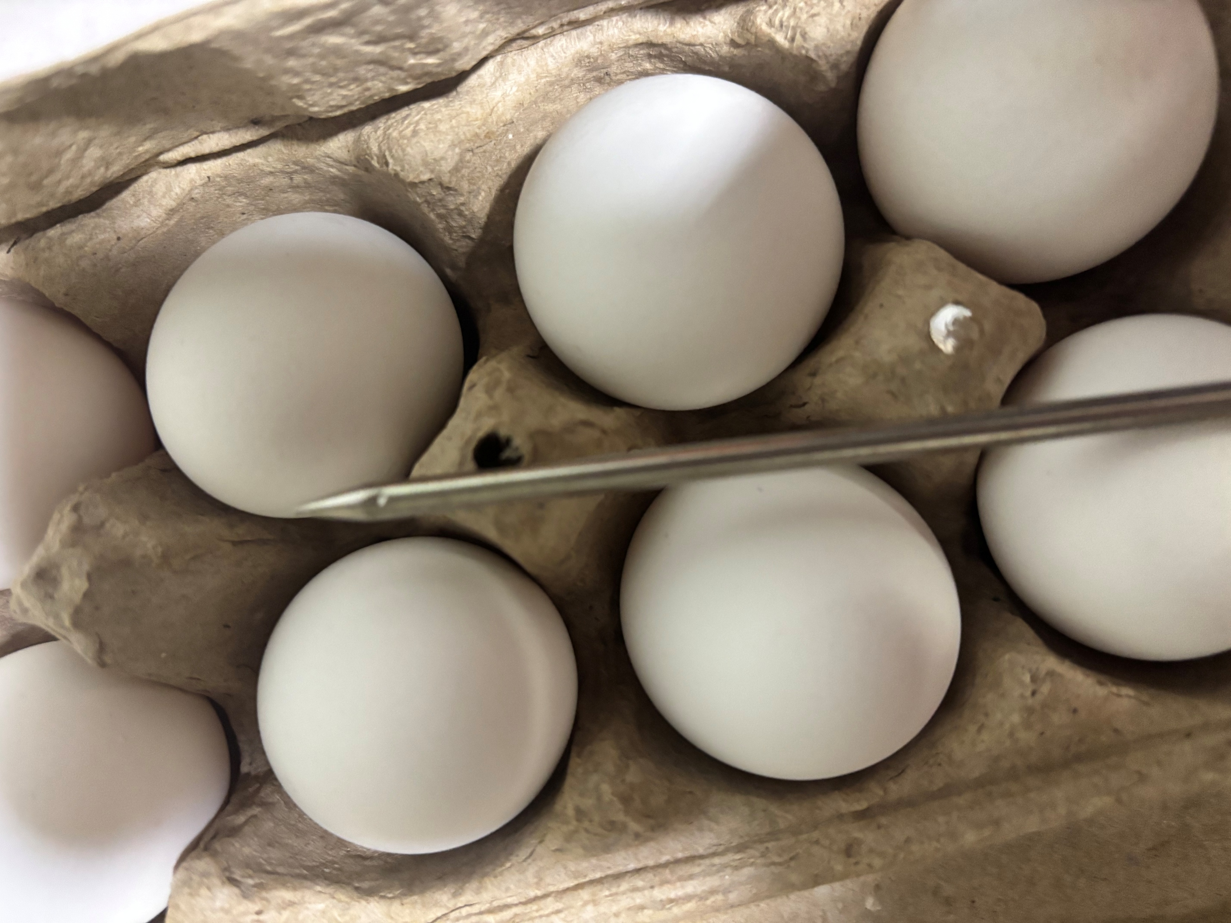
How to Check the Temperature
Temperature Monitoring
Notes:
Here’s the example of where the divot is for the probe thermometer

Slide 10
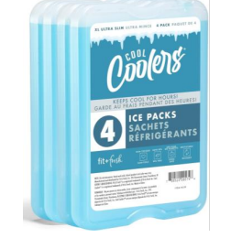
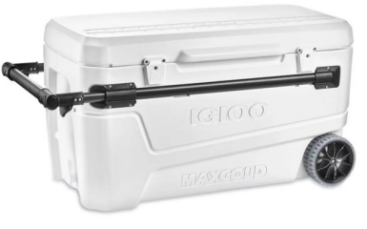
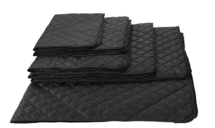
How to Check the Temperature
Temperature Monitoring
Temperature Retention
  Partner must use active temperature retention devices:
    Insulated freezer blankets, ice chests, etc.
    The car’s air conditioning is not enough (Passive temperature retention)
Notes:
Temperature Retention
Partner must use active temperature retention devices:
Insulated freezer blankets, ice chests, etc.
The car’s air conditioning is not enough (Passive temperature retention)
If additional temperature devices are needed, let us know

Slide 11
Safe Temperature Ranges
Decision Trees

Slide 12
Safe Temperature Ranges
Temperature Monitoring
Safe Temperature Ranges
    Cold ≤ 41°F (5°C)
        If cold product is above 41°F (5°C) after setup of distribution, distribute immediately within two hours
        Any cold item above 50°F (10°C) or visible spoilage
          Do not distribute; discard immediately
    Frozen ≤ 0°F (-18°C)
      If a frozen item is above 0°F (-18°C) after set up of distribution, check the Decision Tree for next steps
      Decision Tree
    When using IR thermometer and temperature seems off or not reading correctly
      Verify temp with a probe thermometer
Notes:
Safe Temperature Ranges
Cold ≤ 41°F (5°C)
If cold product is above 41°F (5°C) after setup of distribution, distribute immediately within two hours
Any cold item above 50°F (10°C) or visible spoilage
Do not distribute; discard immediately
Frozen ≤ 0°F (-18°C)
If a frozen item is above 0°F (-18°C) after set up of distribution, check the Decision Tree for next steps
Decision Tree
When using IR thermometer and temperature seems off or not reading correctly
Verify temp with a probe thermometer

Slide 13
Safe Temperature Ranges
Temperature Monitoring
Decision Tree – Frozen Product
Refer to Decision Tree Handout
Notes:
Share the decision tree with the partners and share they will provided handouts of this tree.

Slide 14
Just In Time Delivery
Procedure for Partners Temp Taking
Partners are expected to calibrate their thermometer before distribution
After SHFBOC just-in-time delivery, continue with setup for distribution
Once setup is complete, the partner will sample one cold and one frozen product from the distribution
  If chicken is present for frozen product, temperature must be taken
  If milk is present for cold product, temperature must be taken
  Wait for a stable reading
After temperature is taken, sites will verify if the product is safe for distribution following the temperature guidelines and decision trees
  If product is within the temperature guidelines → continue distribution
  If food is above the temperature guideline → dispose product, temp another product to ensure food safety
For Just In Time distribution, partners will repeat steps b &c, every 30 minutes after set up until distribution has ended
Product not immediately being distributed or on back stock must be kept on proper temp using temperature retention devices (freezer blankets, ice chests, etc.)
Notes:
Walk through the procedure with the partners.
When sampling a product, it just needs to be one frozen and one cold product from the distribution (it does not matter if it’s the one immediately being distributed or in back stock, just one sample of cold or frozen is needed)

Slide 15
Implementation
Temperature Monitoring
After this training, sites will be expected to begin temperature monitoring in their next just-in-time delivery distribution
Every site will receive a digital probe and IR thermometer for temp checking
Sites are expected to have a thermometer on hand during a compliance visit to ensure temperature checking is taking place
  Sites will not be expected to have temperature logs
  Temp checking will be done during compliance visits
  Failure to have a thermometer during compliance visit → automatic non-compliance
Before leaving make sure you received your thermometers

Slide 16
Questions?
Temperature Monitoring
Thank you for taking the time to be here!
Please share any questions or comments ☺

